Slide 1
Dept. of Neurology, Esslingen Medical Center,
Germany
Dept. of Neurology, University of Freiburg, Germany
Perfusion augmentation in acute stroke
using external counterpulsation
Matthias Reinhard
I have no financial interests or relationships to disclose

Slide 2
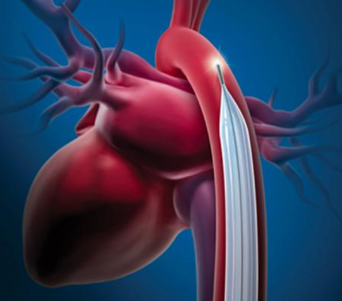
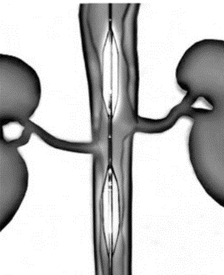
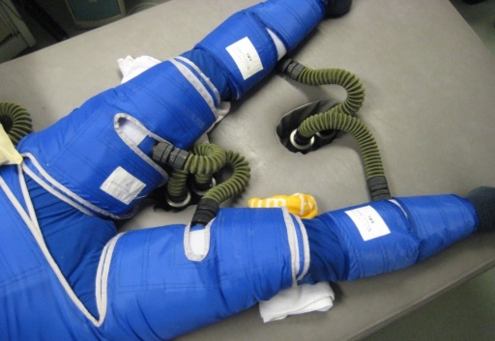
Mechanical blood flow augmentation
→ Redistribution of blood flow to the heart and brain
Intraaortic balloon pump (IABP)
Diastolic counterpulsation
Flow augmentation to coronary arteries
and the brain
→ Cardiogenic shock
Intraaortic balloon (NeuroFlo©)
No counterpulsation, partial obstruction
Flow augmentation to the brain
SENTIS trial, overall negative
Enhanced external counter pulsation
(ECP)
Non-invasive approach
Image: Diagnostic and Interventional Cardiology 2015
Shuaib et al. Stroke 2011
Shuaib et al. Stroke 2011
Notes:
(+effect on systolic afterload) vacuum

Slide 3
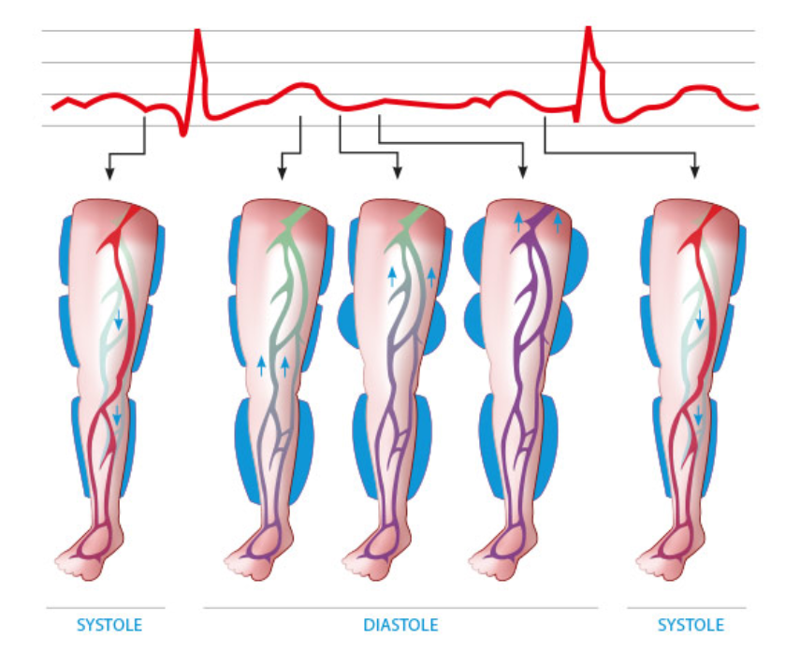
The noninvasive approach: External counterpulsation
Image: Courtesy Dr. Buschmann, Herzhose
Notes:
Enhanced external counterpulsation (ECP) uses three sets of pneumatic cuffs around the lower extremities, which mimics externally what an intra-aortic balloon pump does internally.
External counterpulsation is a non-interventional technique by which diastolic blood flow is enhanced by the sequential inflation of pneumatic cuffs around the lower extremities during each cardiac cycle

Slide 4
Background: ECP in cardiology
Main application of ECP so far: Chronic Coronary artery disease
Sustained improvement of myocardial perfusion Qin et al. PLoS One 2016
Reduction of coronary events Lawson et al. Clin Cardiol 2000
Symptom relief in refractory angina (RCT, MUST-EECP trial; n=139) Arora et al. JACC 1999
European Society of Cardiology (ESC) Guidelines (2019):
Symptom relief in debilitating refractory angina (IIb, B)
Mechanisms of repeated ECP in chronic occlusive disease Bonetti et al. JACC 2003
Collateral growth / recruitment of immature collaterals
Elevated shear rates induced via increased blood flow velocity
Activation of endothelium (release of proangiogenic cytokines)
Smooth muscle cell proliferation, remodeling

Slide 5
External counterpulsation in acute ischemic stroke
Rationale for application in hyperacute stroke
▪ Increase perfusion in the penumbra
▪ Opening of collaterals
▪ Increased washout of thrombi
→ No studies available, recanalizing treatment preferable
Rationale for application in subacute stroke
▪ Direct improvement of tissue perfusion in the peri-infarct cortex
to enhance neuroplasticity and functional recovery
▪ Indirect improvement of brain perfusion via stimulation of collaterals
via increased shear stress Schierling et al. JCBFM 2009

Slide 6
ECP in cerebral circulation: any increase in CBFV?
Lin et al. Stroke 2012
ECP in n=32 patients with acute ischemic stroke (6 days afters stroke)
with intracranial artery occlusive disease
Increase of mean CBFV by 9% ipsi- and contralateral to acute stroke
No increase in healthy controls
Lin et al. Stroke 2012
No increase in CBFV in n=9 healthy persons
Jungehuelsing et al. Cerebrovasc Dis 2010
Healthy persons do have intact autoregulation which counteracts effects of ECP
Patients with stroke do have impaired autoregulation in acute/subacute stage
Reinhard M et al. Stroke 2005, Inthrakaram et al. JCBFM 2019
ECP only seems to increase CBFV in case of impaired autoregulation

Slide 7
ECP in subacute ischemic stroke
Application in China 1988-2003 Wong KS Cerebrovasc Dis 2008
n=22 studies in stroke patients; mostly observational / case series
All with positive outcome
→ No details available, evidence rated as unclear
Effect on clinical outcome Han et al. Stroke 2008
▪ n=50 pts., recent ischemic stroke (<3 months)
▪ Large artery occlusive disease (≥50% stenosis, mostly intracranial)
▪ Treatment: 35 sessions over 1 hour within 7 weeks (cross-over)
▪ Outcome: Early ECP group with better functional outcome (p=0.022)
Potential benefit on clinical outcome in small sample size

Slide 8
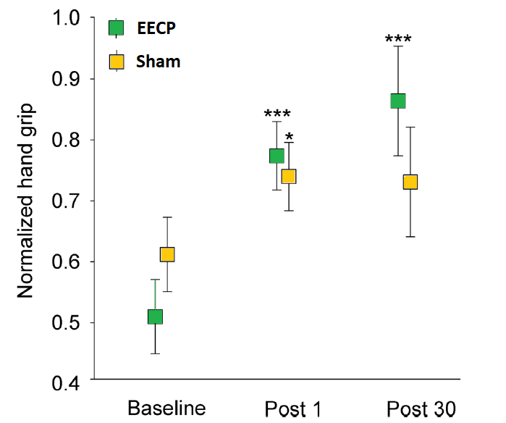
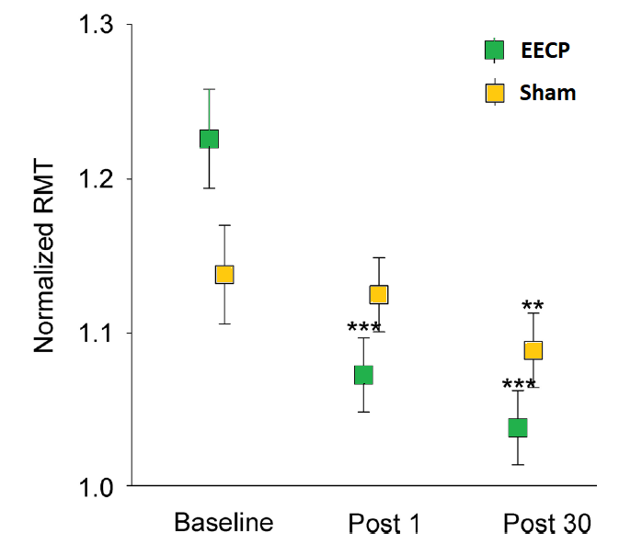
ECP in acute ischemic stroke: Functional recovery
Promotion of functional recovery Liu et al. JNNP 2019
▪ n=30 pts. with subacute stroke (4 to 21 days)
▪ Treatment: 10 sessions of ECP over two weeks vs. sham
Handgrip on paretic side
Motor cortex excitability
(Resting motor threshold)
Benefits for neuroplasticity via improved peri-infarct perfusion?
Graphs modified from Liu et al. JNNP 2019

Slide 9
ECP in chronic cervical/cerebral artery occlusion
The problem of chronic occlusive ICA disease:
Chronic ischemia and exhausted cerebrovascular reactivity in 20% of patients
Brain atrophy, cognitive decline with impaired compensation Silvestrini et al. Neurology 2009
Recurrent stroke risk elevated with impaired compensation Reinhard et al. Neurology 2014
COSS trial Powers et al. JAMA 2011
No benefit of EC-IC Bypass even in patients with poor hemodynamic compensation
Could we improve cerebral collateral hemodynamic compensation
and clinical symptoms in chronic occlusive cerebrovascular disease
using ECP ?

Slide 10
ECP in chronic occlusive carotid disease?
Rat brain:
Collateral arteriogenesis is strongly triggered by increased fluid shear stress Schierling et al. JCBFM 2009
Humans:
No ECP studies with chronic occlusive cerebrovascular disease so far
Aims of our pilot study:
1 Positive short-term effect of ECP on CBFV ?
(as potential stimulus for collateral growth)
2 Direct short-term effects on cerebral oxygenation ?

Slide 11
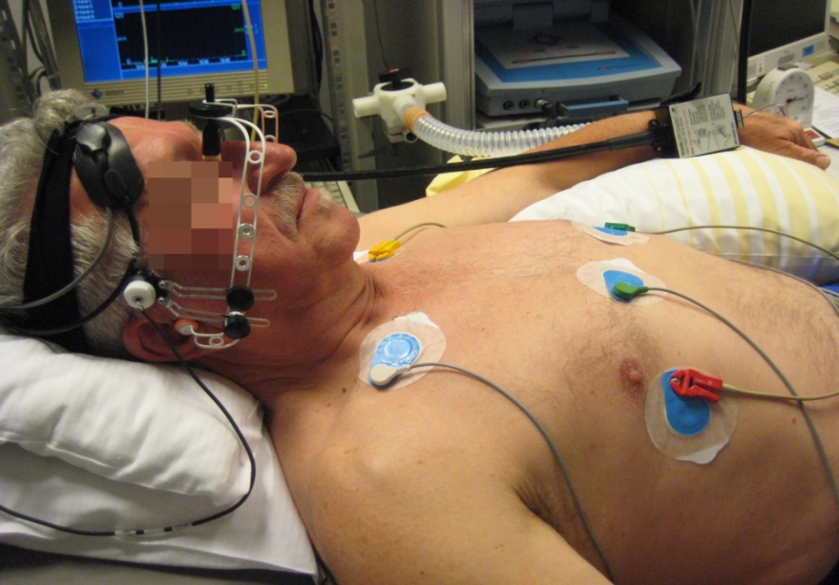
First application in chronic occlusive carotid disease
Methods - Setup:
▪ 28 patients with asymptomatic severe
ICA stenosis (>70%) or occlusion
▪ CBFV measured in both MCA via TCD
▪ Cerebral oxygenation in prefrontal cortex using
NIRS (NIRO 300©)
[Spatially-resolved spectroscopy for
Tissue oxygenation index TOI)
▪ Noninvasive cABP measured using Finapres
Methods – ECP:
▪ TS4 System; Vasomedical Inc., NY, USA
▪ Patients randomized 1:1 to
counterpulsation (20 min. at 180 mmHg)
followed by sham pulsation (80 mmHg)
or vice versa
Buschmann, …, Reinhard Eur J Neurol 2018

Slide 12
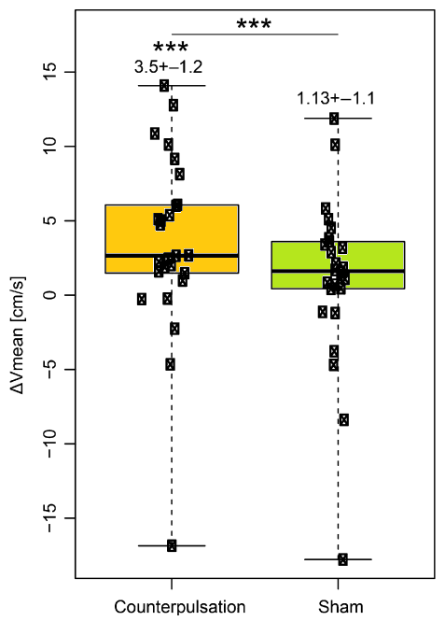
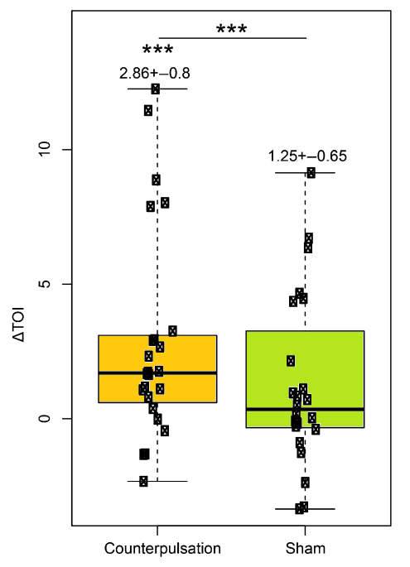
Application in chronic occlusive carotid disease: results
Mean ABP increase by 25.9 ± 2.7 mmHg during ECP [sham: 9.2 ± 2.1 mmHg]
Effect on CBFV
Effect on cerebral oxygenation
Graphs
modified
From
Buschmann
et al. Eur J
Neurol 2018
Significant increase in
mean CBFV during
counterpulsation on affected sides
(not during sham or on unaffected sides)
Significant increase in
Tissue oxygenation index during
counterpulsation on affected sides
(not during sham or on unaffected sides)

Slide 13
Potential therapeutic application in carotid disease ?
Short-term ECP in chronic occlusive disease
Rather small increase in ipsilateral mean CBFV and oxygenation
→ Sufficient stimulus of collateral artery growth?
→ Basis for further clinical investigations on long-term effects of ECP
Open questions:
Potential benefit comparable with coronary microcirculation?
→ Increase of primary (large) Circle of Willis collaterals by ECP less likely
→ But: increase of microvascular pial collaterals seems possible
What is the right dose?
Cardiac ECP treatment: 35 sessions of 1 hour over 4 to 7 weeks
Risks of increasing blood flow / perfusion pressure / angiogenesis?
Potentially intracerebral hemorrhage (low risk assumed)
Notes:
Known contraindications (from cardiac applications):
Aortic or cerebral aneurysm, uncontrolled hypertension (>180/110 mm Hg)
DVT, severe PAD, severe heart failure, arrhythmias (ECG-gated function!)

Slide 14
Conclusions
1
ECP is probably of no value in persons with intact cerebral autoregulation
ECP in hyperacute ischemic stroke has not been investigated so far
and no realistic scenario
Probable positive effects of ECP in subacute stage of ischemic stroke
on clinical function and recovery (larger scale studies necessary, studies
on pathophysiology / perfusion necessary)
ECP in chronic occlusive cerebrovascular disease could be an
attractive field of application, but more basic studies on the
pathophysiology are needed first
2
3
4

Slide 15
Thank you for your
attention!
Klinik für Neurologie und klinische Neurophysiologie

